Slide 1
REVIEW – 2
AI-Powered Civic Connect: Smart Public
Grievance Management System
Smart Public Grievance Tracking System
Team Members
Sejal Heda (2510030350)
Bhavya Potnuru(2510030379)
Thota Lakshmi Hansika(2510030330)
Bachangari Siri(2510030325)
Macharla Mounika(2510030343)
Under the Guidance of:
Dr.P Lalitha Surya Kumari

Slide 2


PROBLEM STATEMENT & OBJECTIVES
Problem Statement
Existing Challenges
Objectives
Road damage
Garbage
Water leakage
Streetlight failures
Drainage
Traffic signals
Issues are reported late and often after they worsen
Manual tracking makes follow-up slow and inconsistent
Field teams lack a unified view of priorities and status
Limited coordination delays repair and response efforts
Enable faster reporting of civic issues
Improve visibility into complaint status and resolution
Prioritize issues based on severity and impact
Support better coordination between stakeholders
Increase efficiency in maintenance and response workflows

Slide 3
LITERATURE REVIEW
Existing System / Research
Major Features
CPGRAMS
Grievance registration, tracking and department handling
Swachhata Platform
Cleanliness complaints, location/image support and status updates
FixMyStreet
Local issue reporting and location-based complaint handling
Recent Research Systems
Automated classification, prioritization, geolocation and duplicate detection
Key Observation
Existing systems provide important complaint registration and tracking facilities, while recent research explores greater automation and intelligent prioritization.

Slide 4
COMPARATIVE ANALYSIS
Feature
Existing Systems
CivicConnect
Complaint Registration
✓
✓
Complaint Tracking
✓
✓
Category Selection
✓
✓
Location Information
✓ / Limited
✓
Department Handling
✓
✓
Duplicate Detection
Limited / Not Core
Proposed ✓
Priority Calculation
Manual / Limited
Proposed ✓
Location-Based Priority
Limited
Proposed ✓
Centralized Management
✓
Proposed ✓
Finding
CivicConnect proposes to integrate complaint registration, tracking, duplicate handling, prioritization and department assignment in one system.

Slide 5
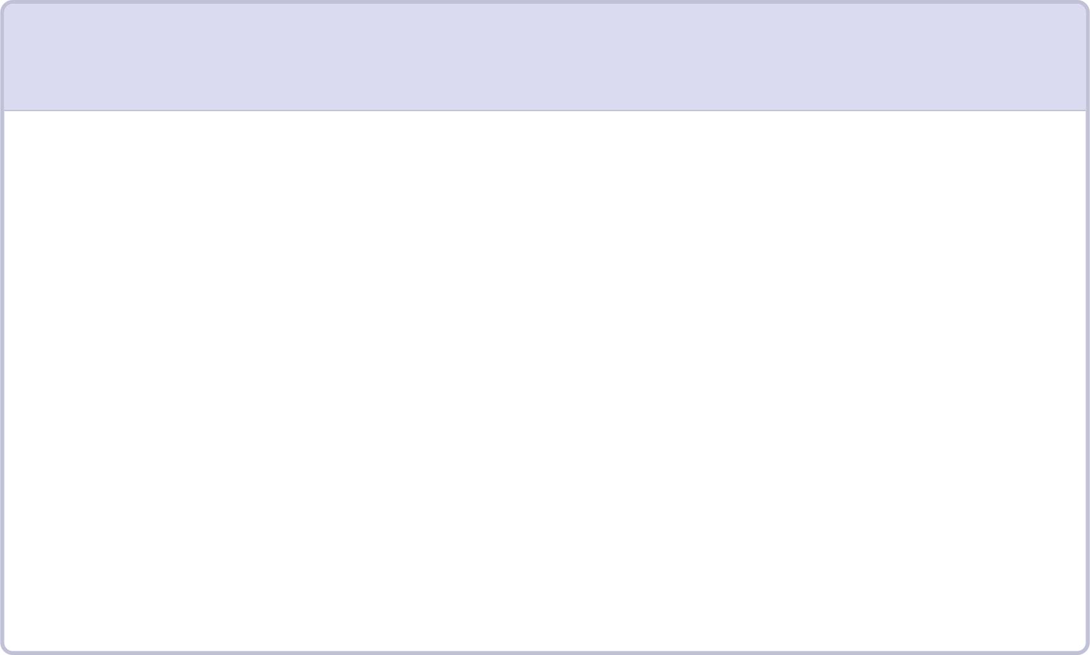
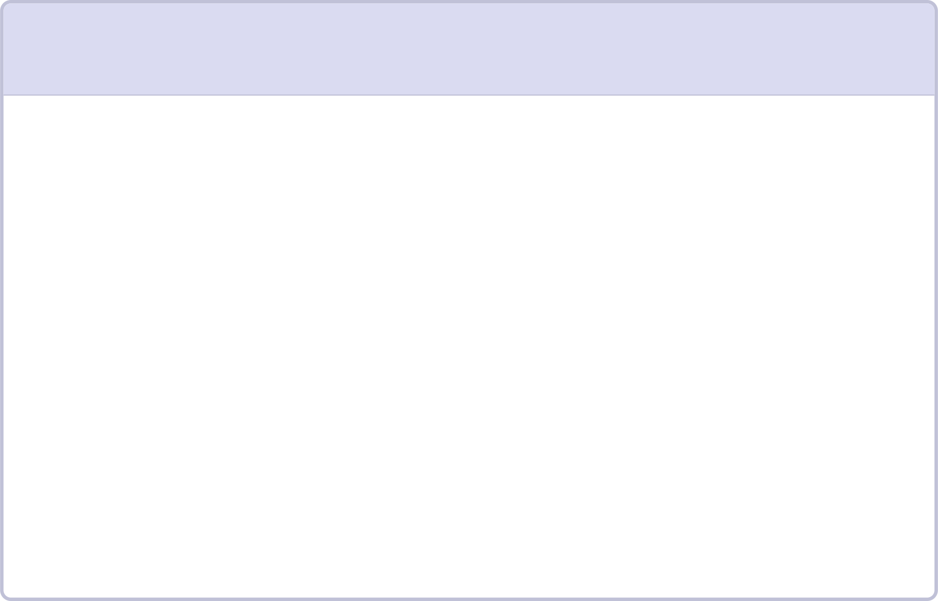
CRITICAL ANALYSIS OF EXISTING SYSTEMS
1
1
Strengths
Limitations / Areas for Improvement
Online complaint registration
Centralized complaint records
Complaint status tracking
Location-based reporting in some systems
Department/authority involvement
Easier access for citizens
Duplicate or related complaints need better handling
Priority assignment can be made more systematic
Location importance can be considered during prioritization
Department routing can be made more structured
Useful features are often distributed across different systems
Our Analysis
There is scope for an integrated grievance system combining registration, duplicate handling, prioritization, department assignment and tracking.

Slide 6
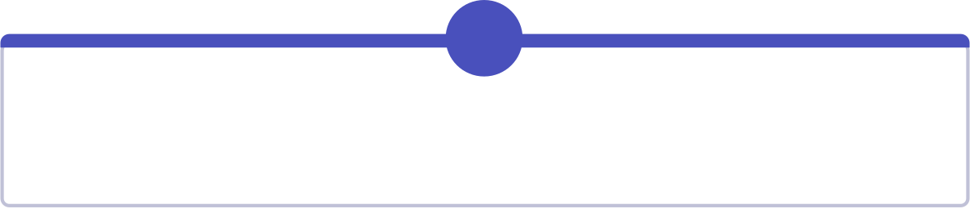
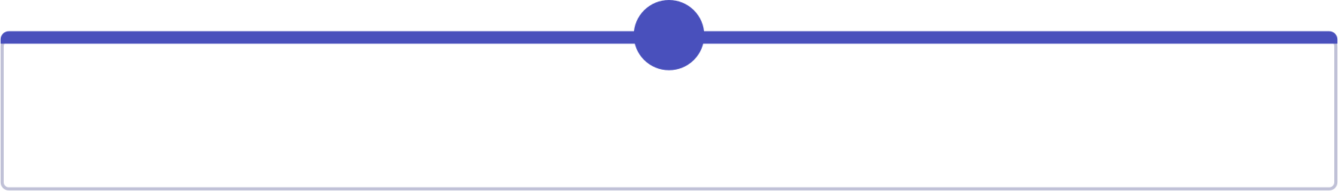

RESEARCH GAP IDENTIFIED
1
2
3
Duplicate Complaint Handling
Priority Assignment
Location-Based Priority
Identify repeated reports related to the same issue.
Rank complaints using predefined factors.
Give additional consideration to important locations.
4
5
Department Assignment
Integrated Tracking
Map complaint categories to the concerned department.
Combine registration, processing and status tracking.
Research Flow
Existing Systems
Analysis
Limitations
Research Gap

Slide 7







CIVICCONNECT — PROPOSED SOLUTION
"CivicConnect is a proposed centralized public grievance tracking system connecting citizens with concerned departments."
Main Features
Citizen Registration
Complaint Registration
Complaint Categorization
Duplicate Detection
Priority Calculation
Department Assignment
Complaint Status Tracking
Goal
To make public grievance handling more organized, transparent and efficient.

Slide 8
COMPLAINT PROCESSING WORKFLOW
CITIZEN
Register Complaint
Select Category & Location
Check Existing Complaints
Identify Duplicate / Related Complaint
Calculate Priority
Assign Department
Department Processes Complaint
Update Status
Citizen Tracks Complaint
In Progress
Resolved

Slide 9
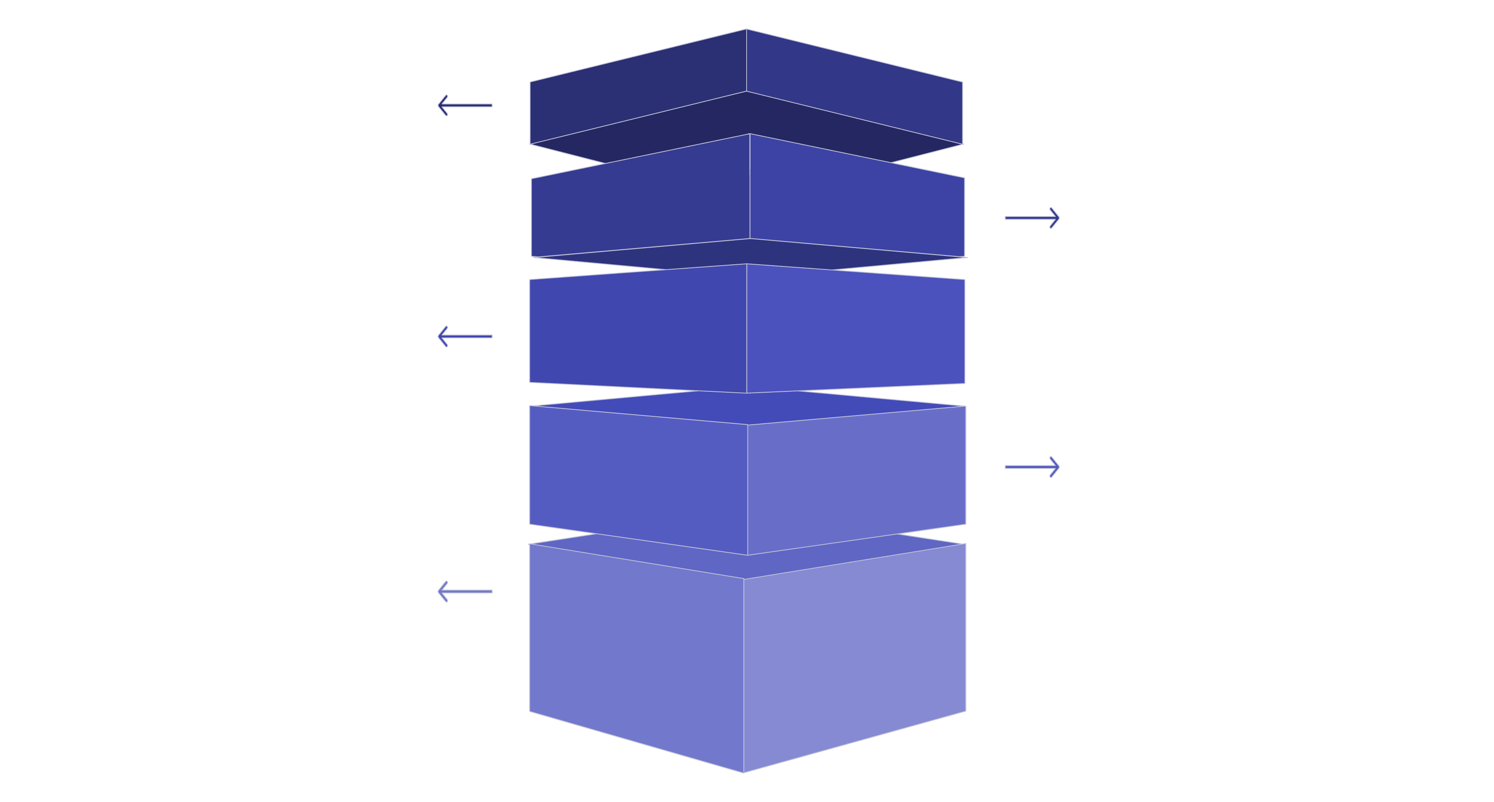
Main Components
PROPOSED SYSTEM ARCHITECTURE
User Interface
System Logic
Duplicate Detection
Priority Logic
Department Assignment
Database
Department Side
Status Management
Citizen
External user initiating requests.
User Interface
Collects input and sends to system.
System / Logic
Orchestrates processing and routing.
Parallel Services
Duplicate, priority, and assignment checks.
Database & Department
Persist data, notify department, update status.

Slide 10
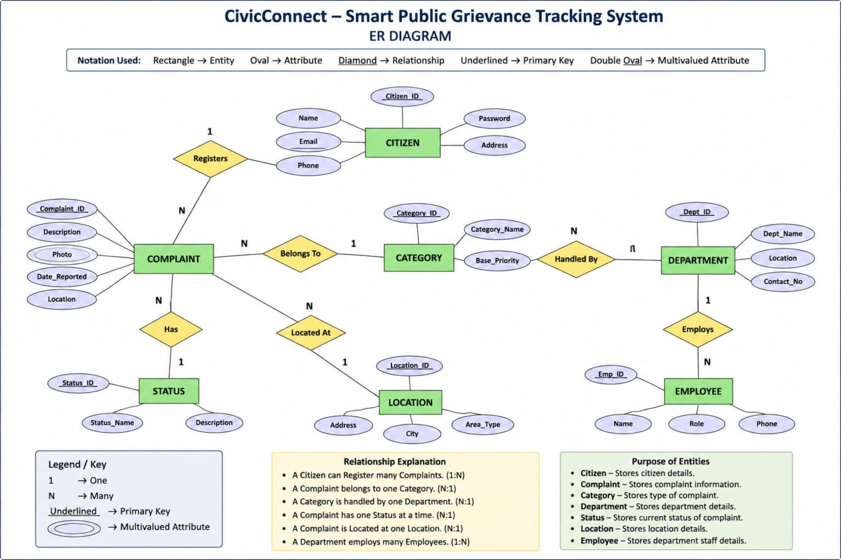
ENTITY RELATIONSHIP DIAGRAM
ER Diagram Rules: Rectangle → Entity, Oval → Attribute, Underlined attribute → Primary Key, Diamond → Relationship, 1 / N → Cardinality. NO foreign keys.

Slide 11
FUTURE IMPLEMENTATION PLAN
Phase
Planned Work
Phase 1
Requirement Analysis & Literature Review
Phase 2
ER Diagram & Database Design
Phase 3
Frontend Development
Phase 4
Backend Development
Phase 5
Priority & Duplicate Logic
Phase 6
Department Module
Phase 7
Testing & Debugging
Phase 8
Final Integration
Proposed Technology Stack
Frontend: HTML, CSS, JavaScript
Backend: Python / Flask
Database: MySQL
If your team hasn't finalized these, label them 'Proposed Technology Stack.'

Slide 12
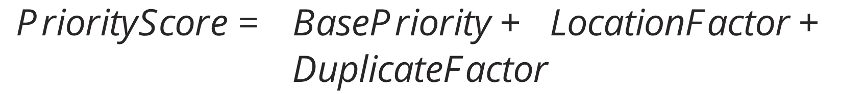
PRIORITY & DUPLICATE DETECTION
Proposed Priority Mechanism
Duplicate Detection
A simple rule-based approach can be proposed:
The proposed system can compare:
Complaint category
Location
Date
Similar issue description
Example section:
If similar complaints are found:
Related/Duplicate → Duplicate Count → Priority consideration
This is a proposed feature, not an implemented feature.
Road Damage
Base Priority = 5
Near School = +3
Multiple Related Reports = +2
Final Priority = 10
Higher score → Higher priority

Slide 13
EXPECTED OUTCOME & CONCLUSION
Expected Outcome
CivicConnect is expected to:
Simplify civic complaint registration
Organize complaints by category
Reduce repeated complaint records
Prioritize important complaints
Route complaints to appropriate departments
Improve transparency through status tracking
Maintain organized grievance information
Conclusion
Literature analysis shows that existing systems provide important grievance-management facilities, while there is scope for better integration of duplicate handling, prioritization, location consideration and department assignment.
CivicConnect proposes an integrated solution to address these gaps.

Slide 14
THANK YOU !!

